Slide 1
Guide to Computer Forensics and Investigations
Fourth Edition
Chapter 12
E-mail Investigations

Slide 2
Objectives
Explain the role of e-mail in investigations
Describe client and server roles in e-mail
Describe tasks in investigating e-mail crimes and violations
Explain the use of e-mail server logs
Describe some available e-mail computer forensics tools

Slide 3
Exploring the Role of E-mail in Investigations

Slide 4
Exploring the Role of E-mail in Investigations
With the increase in e-mail scams and fraud attempts with phishing or spoofing
  Investigators need to know how to examine and interpret the unique content of e-mail messages
Phishing e-mails are in HTML format
  Which allows creating links to text on a Web page
One of the most noteworthy e-mail scams was 419, or the Nigerian Scam
Spoofing e-mail can be used to commit fraud

Slide 5
Munshani v. Signal Lake Venture Fund
Munshani received an email and altered it
But he failed to alter the ESMTP numbers which uniquely identify each message an SMTP server transmits
Comparing ESMTP numbers from the server and the spoofed email revealed the fraud
  Link Ch 12a

Slide 6
Exploring the Roles of the Client and Server in E-mail

Slide 7
Exploring the Roles of the Client and Server in E-mail
Send and receive e-mail in two environments
  Internet
  Controlled LAN, MAN, or WAN
Client/server architecture
  Server OS and e-mail software differs from those on the client side
Protected accounts
  Require usernames and passwords

Slide 8
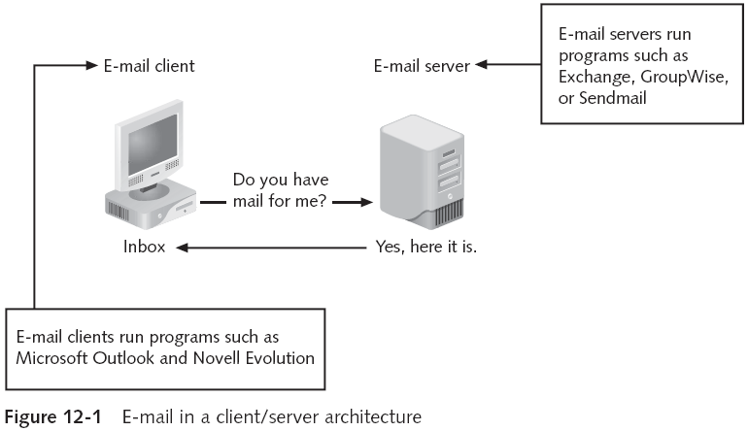
Exploring the Roles of the Client and Server in E-mail (continued)

Slide 9
Exploring the Roles of the Client and Server in E-mail (continued)
Name conventions
  Corporate: john.smith@somecompany.com
  Public: whatever@hotmail.com
  Everything after @ belongs to the domain name
Tracing corporate e-mails is easier
  Because accounts use standard names the administrator establishes

Slide 10
Investigating E-mail Crimes and Violations

Slide 11
Investigating E-mail Crimes and Violations
Similar to other types of investigations
Goals
  Find who is behind the crime
  Collect the evidence
  Present your findings
  Build a case

Slide 12
Investigating E-mail Crimes and Violations (continued)
Depend on the city, state, or country
  Example: spam
  Always consult with an attorney
Becoming commonplace
Examples of crimes involving e-mails
  Narcotics trafficking
  Extortion
  Sexual harassment
  Child abductions and pornography

Slide 13
Examining E-mail Messages
Access victim’s computer to recover the evidence
Using the victim’s e-mail client
  Find and copy evidence in the e-mail
  Access protected or encrypted material
  Print e-mails
Guide victim on the phone
  Open and copy e-mail including headers
Sometimes you will deal with deleted e-mails

Slide 14
Examining E-mail Messages (continued)
Copying an e-mail message
  Before you start an e-mail investigation
    You need to copy and print the e-mail involved in the crime or policy violation
  You might also want to forward the message as an attachment to another e-mail address
With many GUI e-mail programs, you can copy an e-mail by dragging it to a storage medium
  Or by saving it in a different location

Slide 15
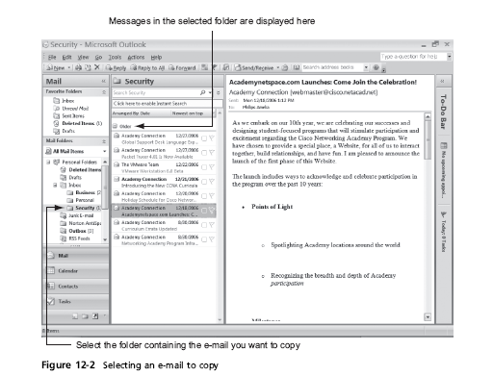
Examining E-mail Messages (continued)

Slide 16
Viewing E-mail Headers
Learn how to find e-mail headers
  GUI clients
  Command-line clients
  Web-based clients
After you open e-mail headers, copy and paste them into a text document
  So that you can read them with a text editor
Headers contain useful information
  Unique identifying numbers, IP address of sending server, and sending time

Slide 17
Viewing E-mail Headers (continued)
Outlook
  Open the Message Options dialog box
  Copy headers
  Paste them to any text editor
Outlook Express
  Open the message Properties dialog box
  Select Message Source
  Copy and paste the headers to any text editor

Slide 18
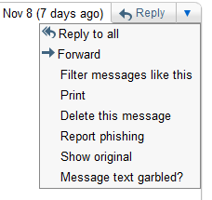
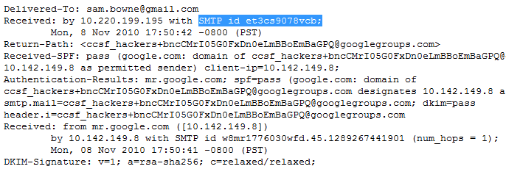
Email Headers in Gmail
Click “Reply” drop-down arrow, “Show original”

Slide 19
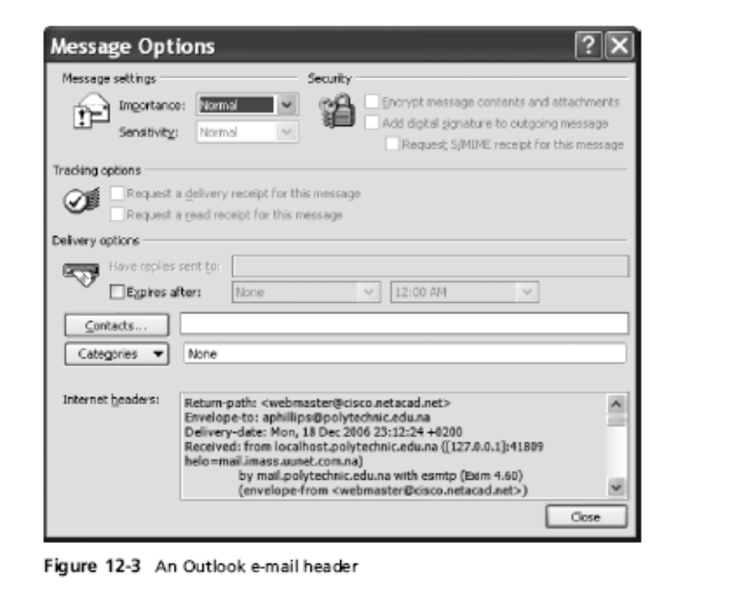
Viewing E-mail Headers (continued)

Slide 20
Examining E-mail Headers
Gather supporting evidence and track suspect
  Return path
  Recipient’s e-mail address
  Type of sending e-mail service
  IP address of sending server
  Name of the e-mail server
  Unique message number
  Date and time e-mail was sent
  Attachment files information
    See link Ch 12b for an example—tracing the source of spam

Slide 21
Examining Additional E-mail Files
E-mail messages are saved on the client side or left at the server
Microsoft Outlook uses .pst and .ost files
Most e-mail programs also include an electronic address book
In Web-based e-mail
  Messages are displayed and saved as Web pages in the browser’s cache folders
  Many Web-based e-mail providers also offer instant messaging (IM) services

Slide 22
Tracing an E-mail Message
Contact the administrator responsible for the sending server
Finding domain name’s point of contact
  www.arin.net
  www.internic.com
  www.freeality.com
  www.google.com
Find suspect’s contact information
Verify your findings by checking network e-mail logs against e-mail addresses

Slide 23
Using Network E-mail Logs
Router logs
  Record all incoming and outgoing traffic
  Have rules to allow or disallow traffic
  You can resolve the path a transmitted e-mail has taken
Firewall logs
  Filter e-mail traffic
  Verify whether the e-mail passed through
You can use any text editor or specialized tools

Slide 24
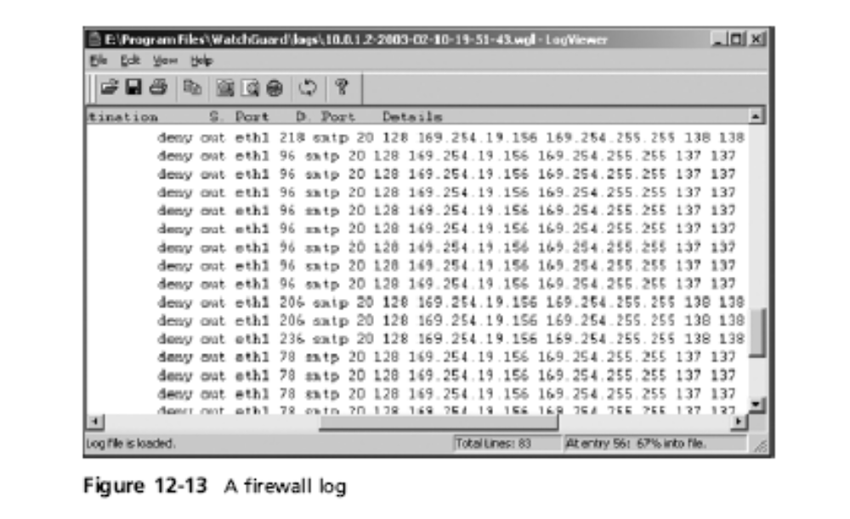
Using Network E-mail Logs (continued)

Slide 25
Understanding E-mail Servers

Slide 26
Understanding E-mail Servers
Computer loaded with software that uses e-mail protocols for its services
  And maintains logs you can examine and use in your investigation
E-mail storage
  Database
  Flat file
Logs
  Default or manual
  Continuous and circular

Slide 27
Understanding E-mail Servers (continued)
Log information
  E-mail content
  Sending IP address
  Receiving and reading date and time
  System-specific information
Contact suspect’s network e-mail administrator as soon as possible
Servers can recover deleted e-mails
  Similar to deletion of files on a hard drive

Slide 28
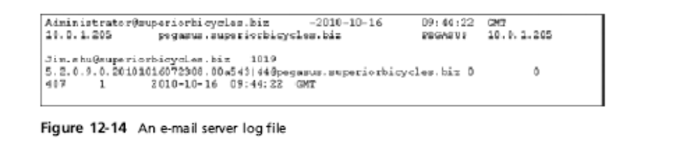
Understanding E-mail Servers (continued)

Slide 29
Examining UNIX E-mail Server Logs
/etc/sendmail.cf
  Configuration information for Sendmail
/etc/syslog.conf
  Specifies how and which events Sendmail logs
/var/log/maillog
  SMTP and POP3 communications
    IP address and time stamp
Check UNIX man pages for more information

Slide 30
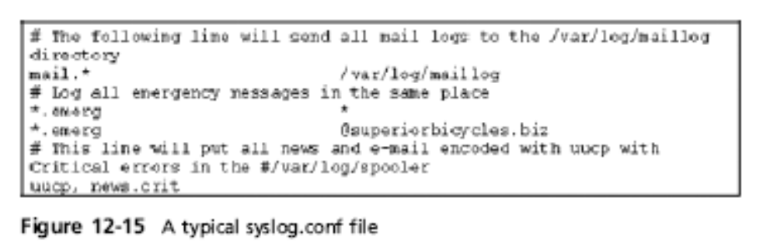
Examining UNIX E-mail Server Logs (continued)

Slide 31
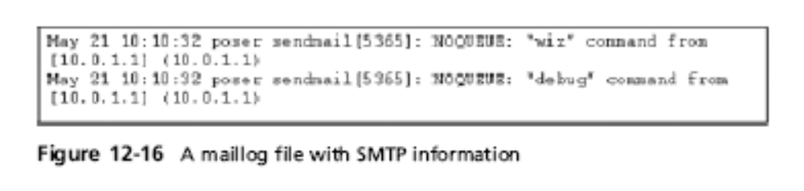
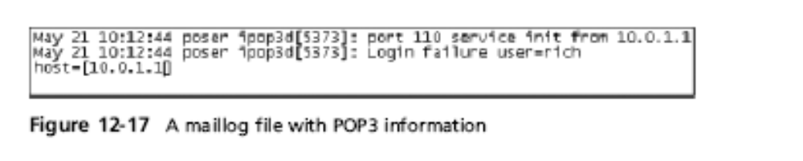
Examining UNIX E-mail Server Logs (continued)

Slide 32
Examining Microsoft E-mail Server Logs
Microsoft Exchange Server (Exchange)
  Uses a database
  Based on Microsoft Extensible Storage Engine
Messaging Application Programming Interface (MAPI)
  A Microsoft system that enables different e- mail applications to work together

Slide 33
Examining Microsoft E-mail Server Logs
The “Information Store” is made of tw0 files
  Database files *.edb
    Responsible for MAPI information
  Database files *.stm
    Responsible for non-MAPI information

Slide 34
Examining Microsoft E-mail Server Logs (continued)
Administrators can recover lost or deleted emails from these files:
  Transaction log
    Keep track of e-mail databases
  Checkpoints
    Marks the place in the transaction log where the last backup was made

Slide 35
Examining Microsoft E-mail Server Logs (continued)
Other useful files
  Temporary files
  E-mail communication logs
    res#.log
  Tracking.log
    Tracks messages

Slide 36
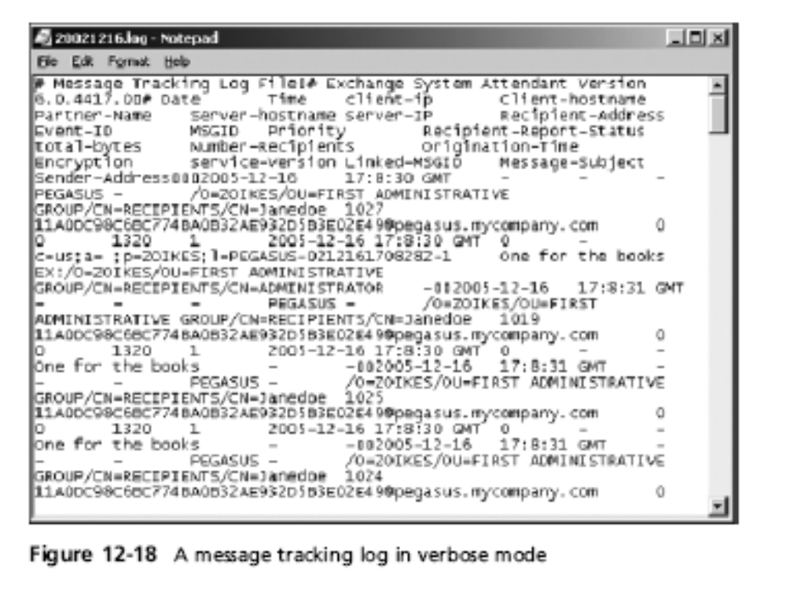
Examining Microsoft E-mail Server Logs (continued)

Slide 37
Examining Microsoft E-mail Server Logs (continued)
Troubleshooting or diagnostic log
  Logs events
  Use Windows Event Viewer
  Open the Event Properties dialog box for more details about an event

Slide 38
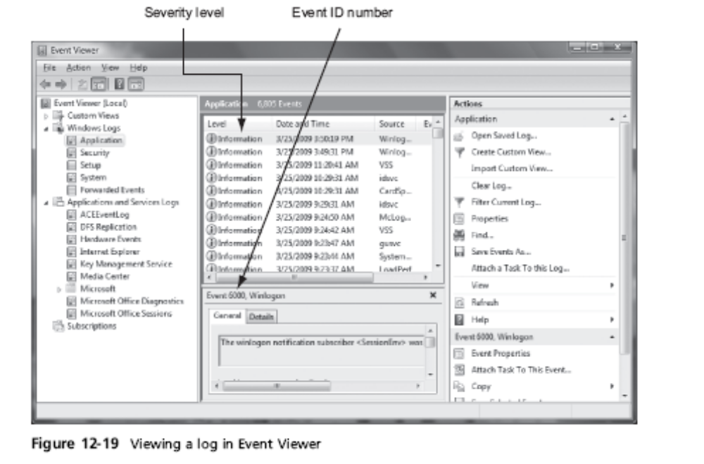
Examining Microsoft E-mail Server Logs (continued)

Slide 39
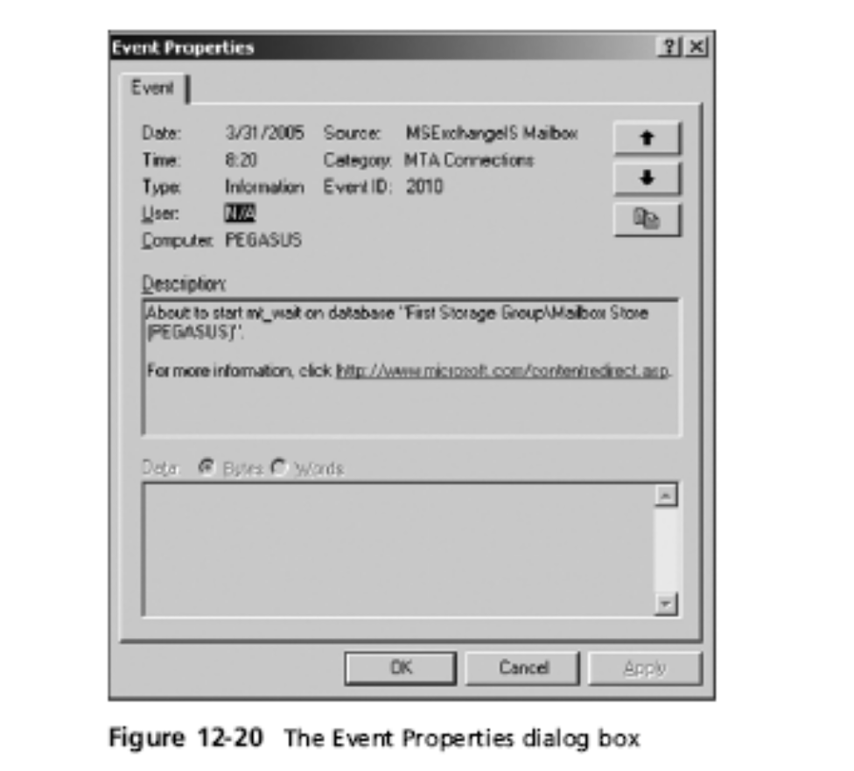
Examining Microsoft E-mail Server Logs (continued)

Slide 40
Examining Novell GroupWise E-mail Logs
Up to 25 databases for e-mail users
  Stored on the Ofuser directory object
  Referenced by a username, an unique identifier, and .db extension
Shares resources with e-mail server databases
Mailboxes organizations
  Permanent index files
  QuickFinder

Slide 41
Examining Novell GroupWise E-mail Logs (continued)
Folder and file structure can be complex
  It uses Novell directory structure
Guardian
  Directory of every database
  Tracks changes in the GroupWise environment
  Considered a single point of failure
Log files
  GroupWise generates log files (.log extension) maintained in a standard log format in GroupWise folders

Slide 42
Using Specialized E-mail Forensics Tools

Slide 43
Using Specialized E-mail Forensics Tools
Tools include:
  AccessData’s Forensic Toolkit (FTK)
  ProDiscover Basic
  FINALeMAIL
  Sawmill-GroupWise
  DBXtract
  Fookes Aid4Mail and MailBag Assistant
  Paraben E-Mail Examiner
  Ontrack Easy Recovery EmailRepair
  R-Tools R-Mail

Slide 44
Using Specialized E-mail Forensics Tools (continued)
Tools allow you to find:
  E-mail database files
  Personal e-mail files
  Offline storage files
  Log files
Advantage
  Do not need to know how e-mail servers and clients work

Slide 45
Using Specialized E-mail Forensics Tools (continued)
FINALeMAIL
  Scans e-mail database files
  Recovers deleted e-mails
  Searches computer for other files associated with e-mail

Slide 46
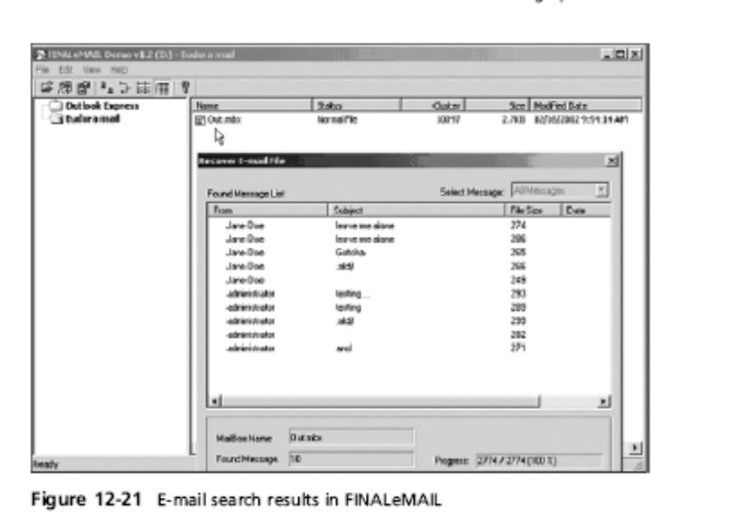
Using Specialized E-mail Forensics Tools (continued)

Slide 47
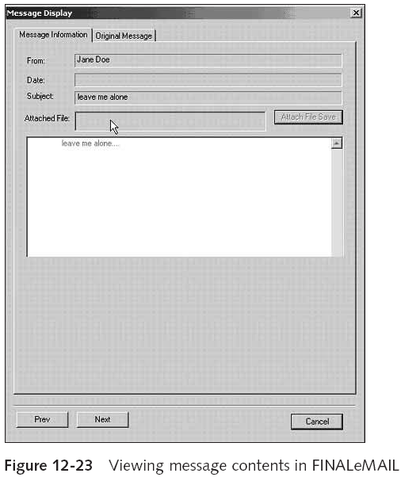
Using Specialized E-mail Forensics Tools (continued)

Slide 48
Using AccessData FTK to Recover
E-mail
FTK
  Can index data on a disk image or an entire drive for faster data retrieval
  Filters and finds files specific to e-mail clients and servers
To recover e-mail from Outlook and Outlook Express
  AccessData integrated dtSearch
    dtSearch builds a b-tree index of all text data in a drive, an image file, or a group of files

Slide 49
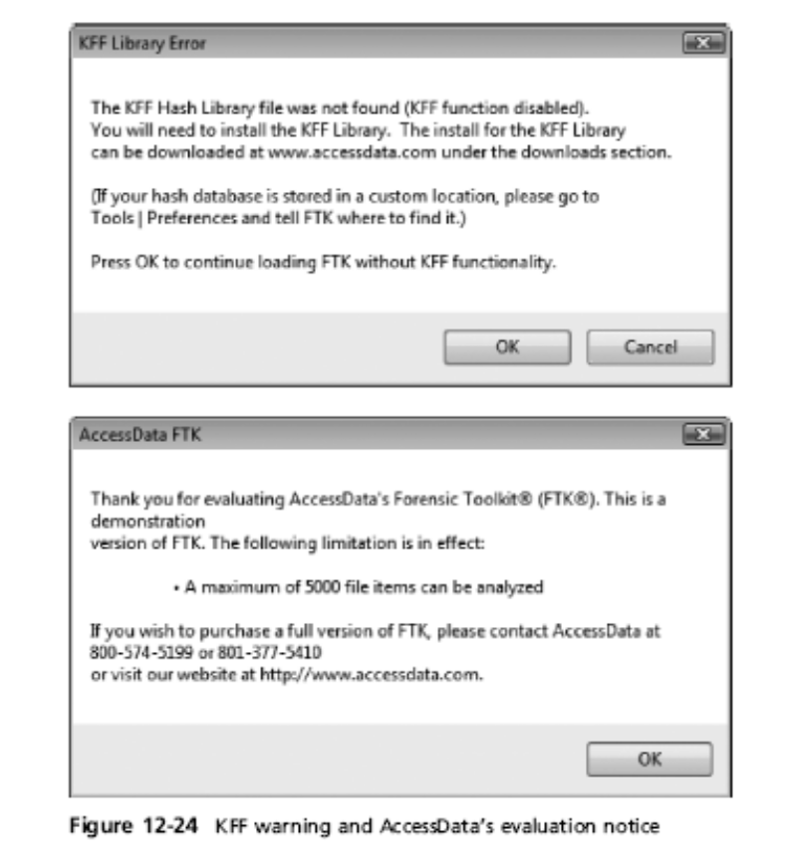
Using AccessData FTK to Recover
E-mail (continued)

Slide 50
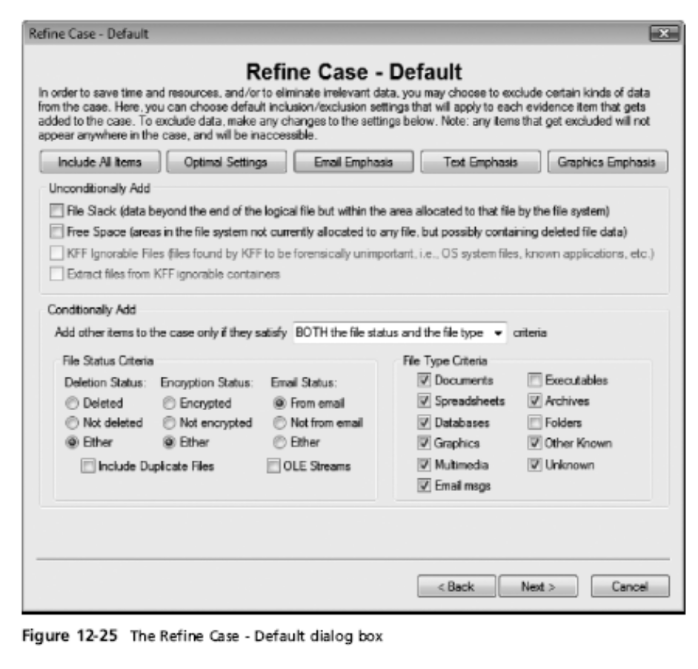
Using AccessData FTK to Recover
E-mail (continued)

Slide 51
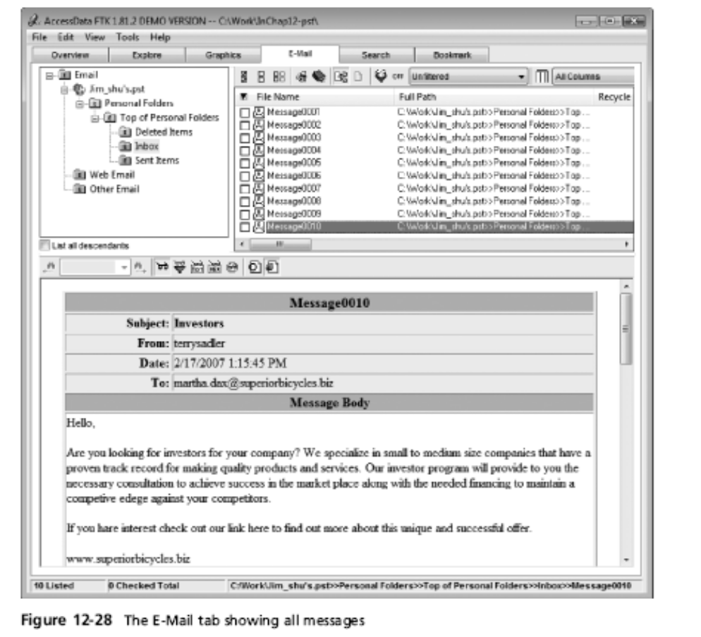
Using AccessData FTK to Recover
E-mail (continued)

Slide 52
Using a Hexadecimal Editor to Carve E-mail Messages
Very few vendors have products for analyzing e-mail in systems other than Microsoft
mbox format
  Stores e-mails in flat plaintext files
Multipurpose Internet Mail Extensions (MIME) format
  Used by vendor-unique e-mail file systems, such as Microsoft .pst or .ost
Example: carve e-mail messages from Evolution

Slide 53
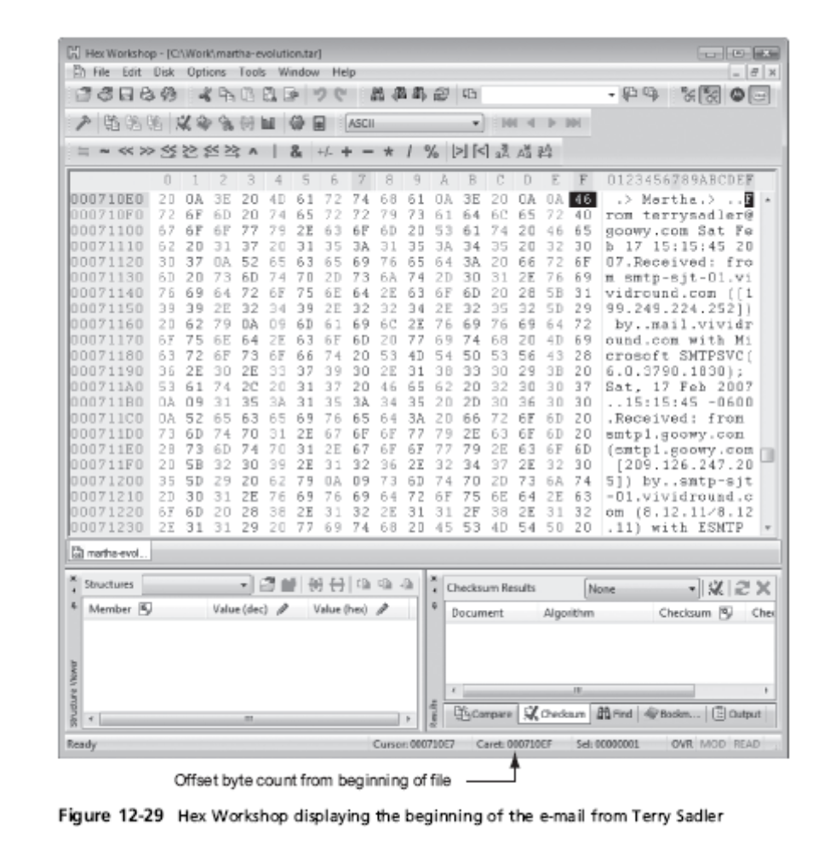

Slide 54
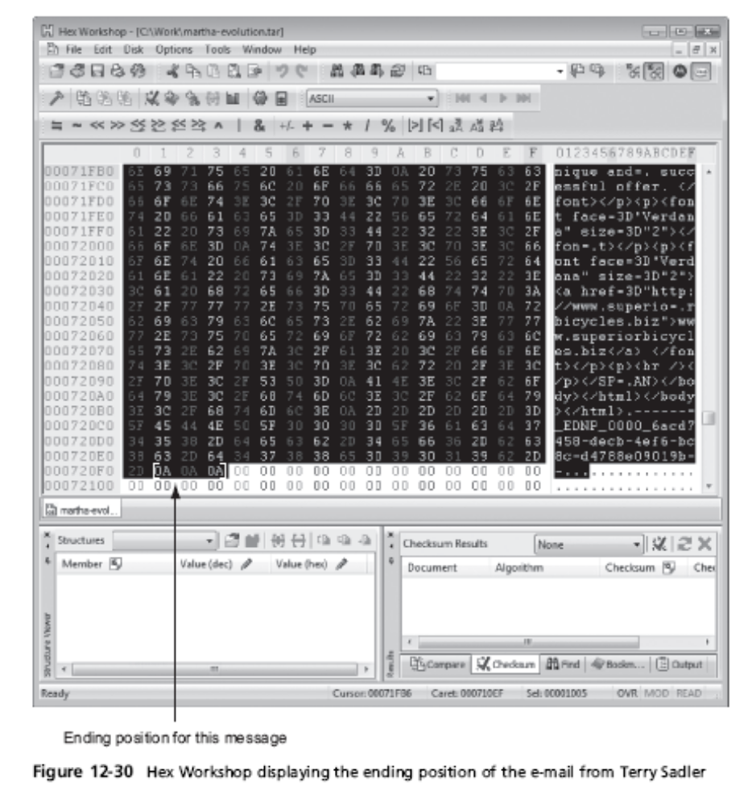

Slide 55
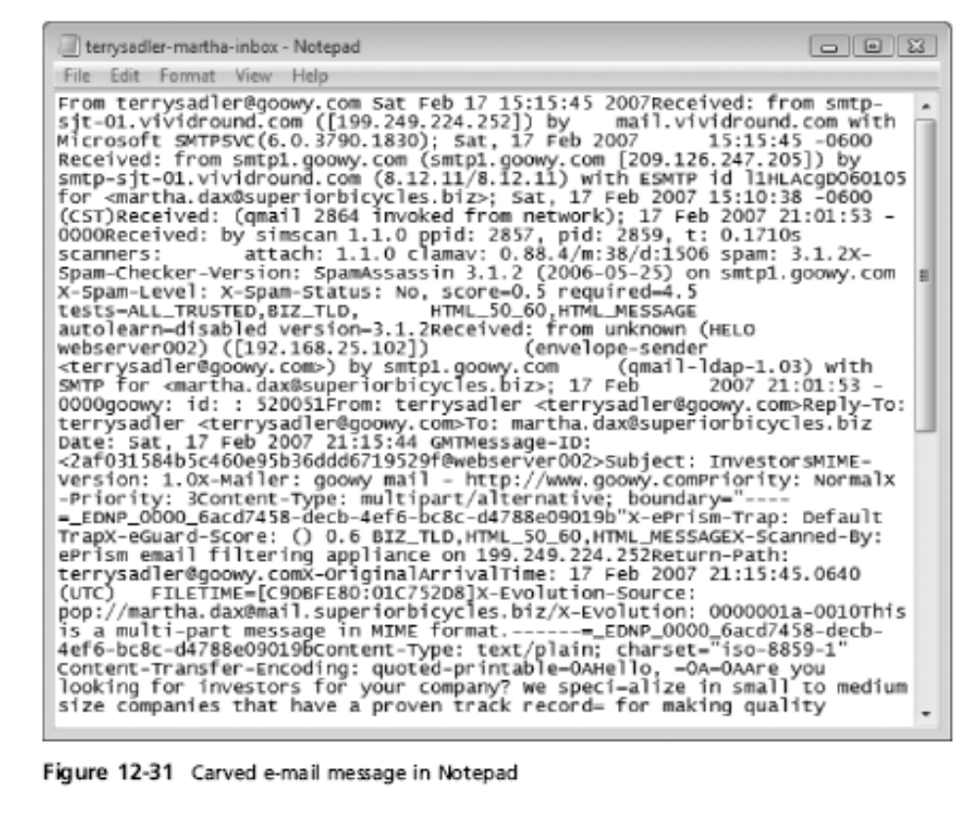
Using a Hexadecimal Editor to Carve E-mail Messages (continued)

Slide 56
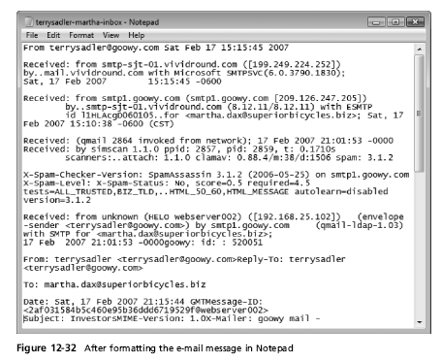
Using a Hexadecimal Editor to Carve E-mail Messages (continued)

Slide 57
Recovering Deleted Outlook Files
Microsoft's Inbox Repair Tool (scanpst)
  http://office.microsoft.com/en-001/outlook-help/repair-outlook-data-files-pst-and-ost-HA010075831.aspx
  www.outlook-tips.net/beginner/scanpst.htm
  www.slipstick.com/outlook/config/recover-deleted-messages-pst-files/

Slide 58
Recovering Deleted Outlook Files
  EnCase
  http://encase-forensic-blog.guidancesoftware.com/2014/04/systools-outlook-exporter-for-encase-no.html
Advanced Outlook Repair from DataNumen, Inc.
  www.datanumen.com/outlook-repair

